Slide 1
Gettysburg Address Abraham Lincoln
Mikayla Nessa Dalton

Slide 2
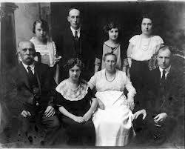
Abraham Lincoln
1. Born on February 12, 1809.
2. He had 4 kids, Robert Lincoln, William Lincoln, Tad Lincoln, and Edward Lincoln.
3. He had one wife named, Mary Lincoln.
4. He was the son of Kentucky Frontiersmen.
5. He was the 16 president.

Slide 3
Historical Background:
This text was written on, November 19, 1863, and it was written to honor the bravery and valor of the soldiers, who laid down their lives for America. The Civil War was going on at this point in time.

Slide 4
Literary Devices:
Personification: A new nation so conceived and so dedicated.
Anaphora: We cannot dedicate, we cannot consecrate we cannot hallow this ground.
Personification: The world will little note, nor long remember what we say here.

Slide 5
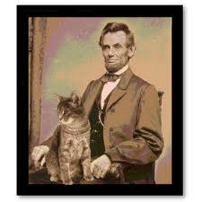
Summary:
Lincoln's main idea in his Gettysburg Address was to extol liberty and honor the people fighting for our nation, who died in hope that there would still be a nation in the end.The battle of gettysburg address occurred four months apart. By 1863, Abraham Lincoln was in the third years of his troubled presidency, and the devastating American Civil War.

Slide 6
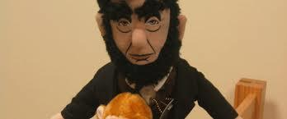
Relevance:
It is important today because, it is one of the briefest speeches ever made. And we should still learn this because it is part of our country. Its important because of our soldiers fighting for our country and risking their lives.

