Slide 1
A Quilt Of A Country Anna Quindlen
Hope Schmidt
Audrye Lehmann
Jonathan Schneider
4th Hour

Slide 2
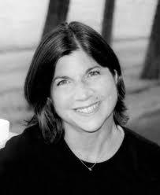
Anna Quindlen
She wrote the text after 9/11
2. She won the Pulitzer Prize of commentary in 1992.
3. Anna was in a mixed marriage.

Slide 3
Historical Background
The text was written soon after 9/11
In the history, racism and inequality was happening. America classified people of different diverse backgrounds.
To show diversity among the people of America.

Slide 4
Summary
The text explains racism in our country. Then goes to show that people aren't so different after all. It explains how our country bonds together when having enemies. Though it also states how we as a people still discriminant. How the different types of people from different nations come together and create a multi cultural population.

Slide 5
Relevance
It's important because it states how our country was built and founded today. How people need to be more diverse today. It explains how our nation was different from today. It also shows the events that have led up to this present day.

Slide 6
Literary Devices
Metaphor:
"America is an improbable idea."
Personification:
"Tolerance is the word used most often when this kind of coexistence succeeds, but tolerance is a vanilla-pudding word".
Alliteration:
"That amid all the failures is something spectacularly successful."

